Slide 1
ICMEs and Magnetic Clouds Session Summary
Charlie Farrugia and Lan Jian

Slide 2
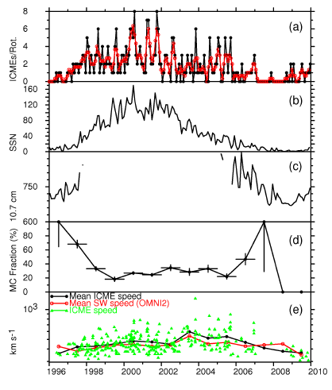
Ian Richardson
Manifold signatures of ICMEs
24 signatures (mag, plasma, composition, engertic particle, charge states, cosmic ray depression, etc.)
None is unique or sufficient to identify ICMEs
Solar cycle variation of ICMEs and MCs

Slide 3
Main Points

Slide 4
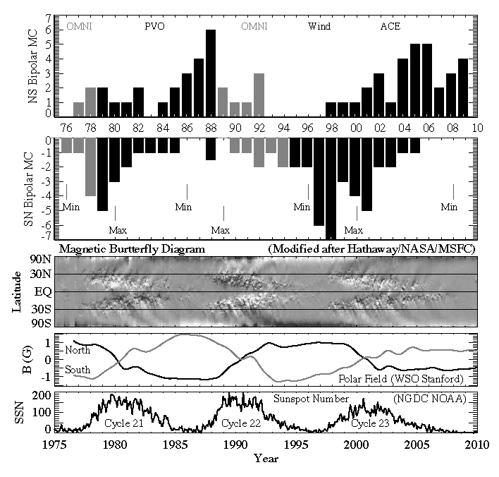
MC Polarity Reversal over Three Sunspot Cycle
Y. Li
SSL/UCB
The poloidal field of low
inclination MCs reverses
on the solar cycle scale.
The leading edge of MCs
has the same field
direction with the solar
dipole field.
Over 3 sunspot
cycles of annual occurrences
of NS and SN MCs combining
our results from Wind and
ACE data (1995-2009),
PVO results (1979-1988)
by Mulligan et al. (1998)
and OMNI results (grey bar)
by Bothmer and Rust (1997)

Slide 5
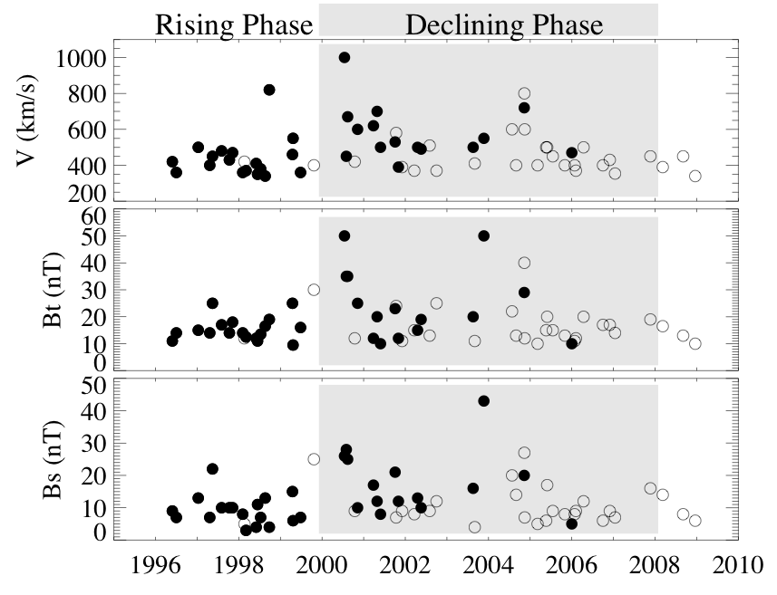
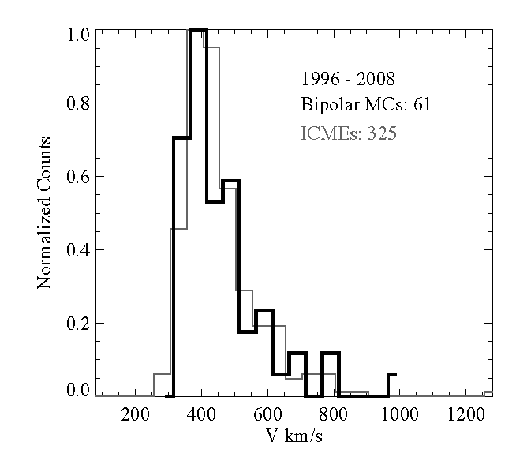
Properties of bipolar MCs in solar cycle 23
Y. Li
SSL/UCB
Filled circle: SN MCs; Open circle: NS MCs
MIN
MAX
MIN
Bipolar MC parameter variation
with time in solar cycle 23.
Bipolar MCs have the same
speed distribution with all ICMEs.
NP SP
reversal

Slide 6
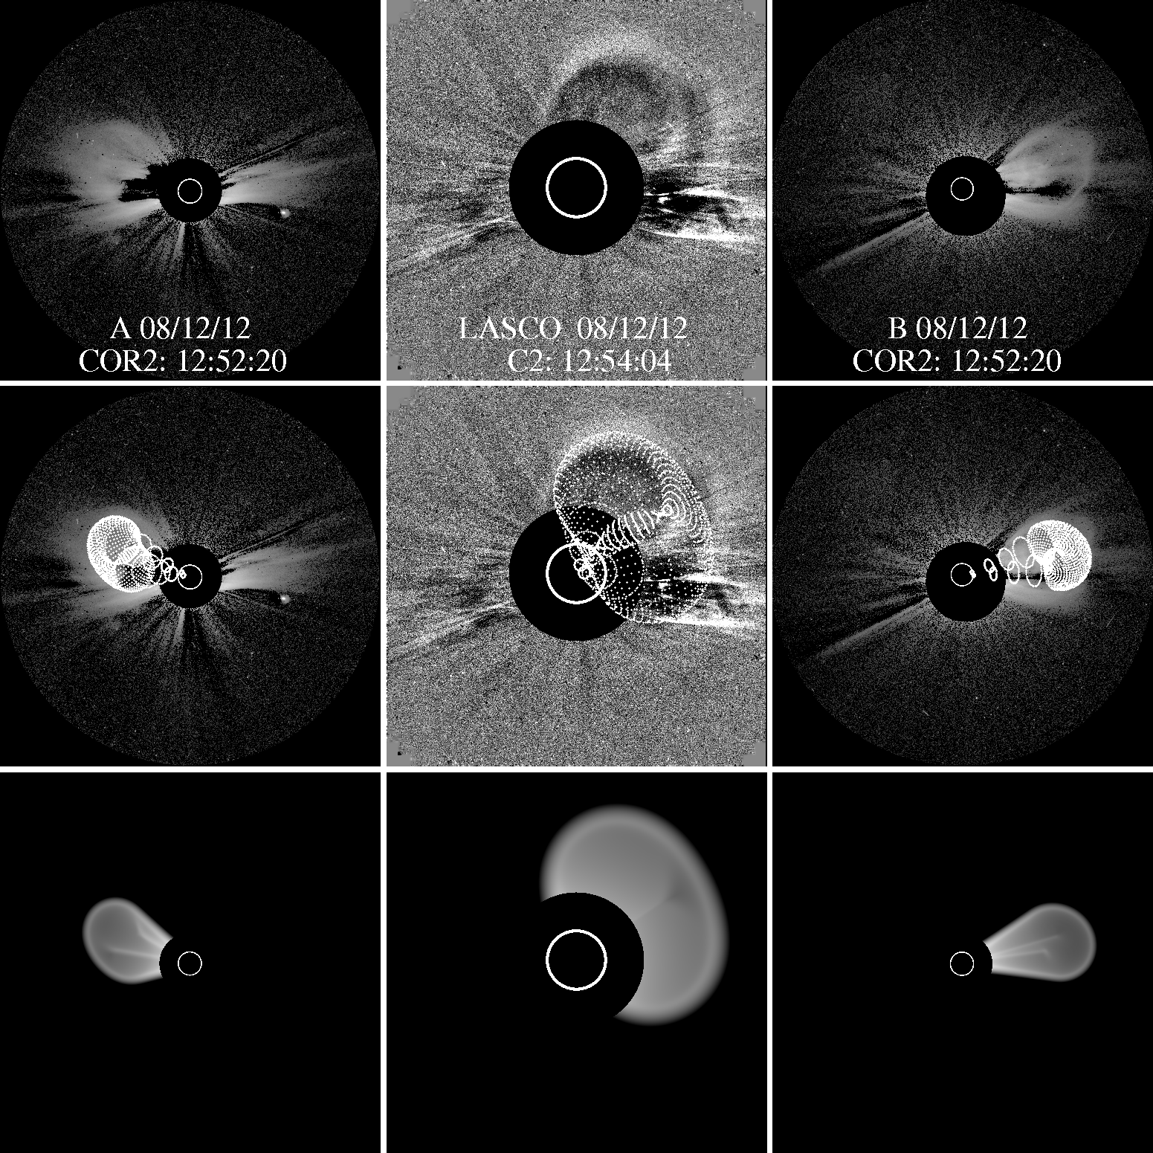
Reconstructing CMEs with coordinated imaging and in situ data
Ying Liu (SSL, UCB)
Combine images with in situ data to constrain the global structure and kinematics of CMEs:
Image modeling gives propagation direction and rope orientation (Thernisien);
Geometric triangulation gives propagation direction, radial distance, velocity and arrival time;
All these results are compared with in situ measurements and reconstruction.
Geometric triangulation
Image forward modeling
In situ data
In situ reconstruction

Slide 7
Main conclusions
CME propagation directions can be determined to a relatively good precision as shown by the consistency between different methods;
The geometric triangulation technique shows a promising capability to link solar observations with corresponding in situ signatures at 1 AU and to predict CME arrival at the Earth;
The flux-rope orientation derived from imaging observations may have a large uncertainty as indicated by the comparison with in situ reconstruction;
The flux rope within CMEs, which has the most hazardous southward magnetic field, cannot be imaged at large distances due to expansion;
We find that CMEs undergo a westward migration with respect to the Sun-Earth line at their acceleration phase, which we suggest as a universal feature produced by the magnetic field connecting the Sun and ejecta.

Slide 8
Dusan Odstrcil: MHD Modeling of ICMEs Initialized by Cone- and Rope-Model Fittings of Coronagraph Observations, and Comparison with Observations
Cone model vs. rope model
Rope model is more consistent with observations
Different solar input can lead to discrepancies
Other
Additional parameters from multipoint can put more constraints on the model and input the model

Slide 9
Cone Model
CME – Hydrodynamic Models
Elliptical Cone Model
Rope Model
Tilt
Tilt
FRONT VIEW
Lat
Lat
Lat
Lon
Lon
Lon
Rmajor
Rmajor
Rmajor
SIDE VIEW
Rleg
Rminor

Slide 10
Apr 26, 2008

Slide 11
Jack Gosling: Small Flux Ropes, Torsional Alfven Waves, Reconnection Exhausts in Connection with ICMEs

Slide 12
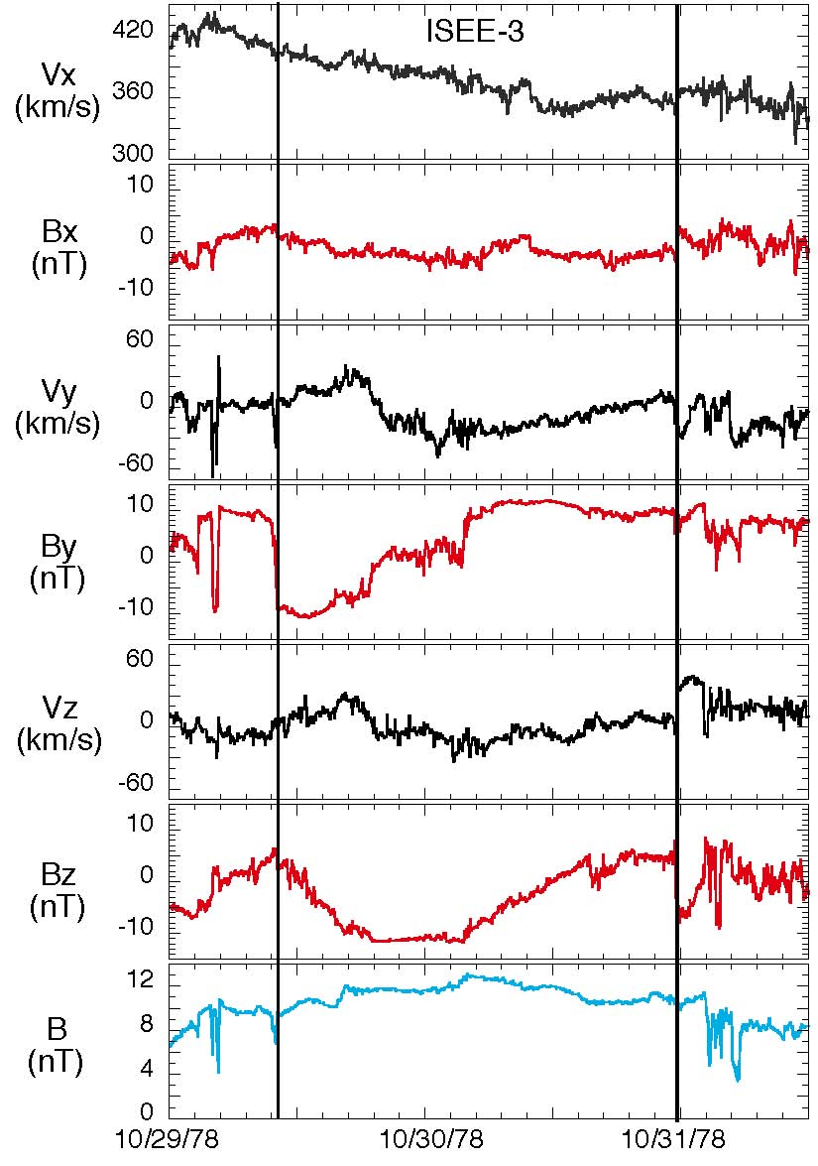
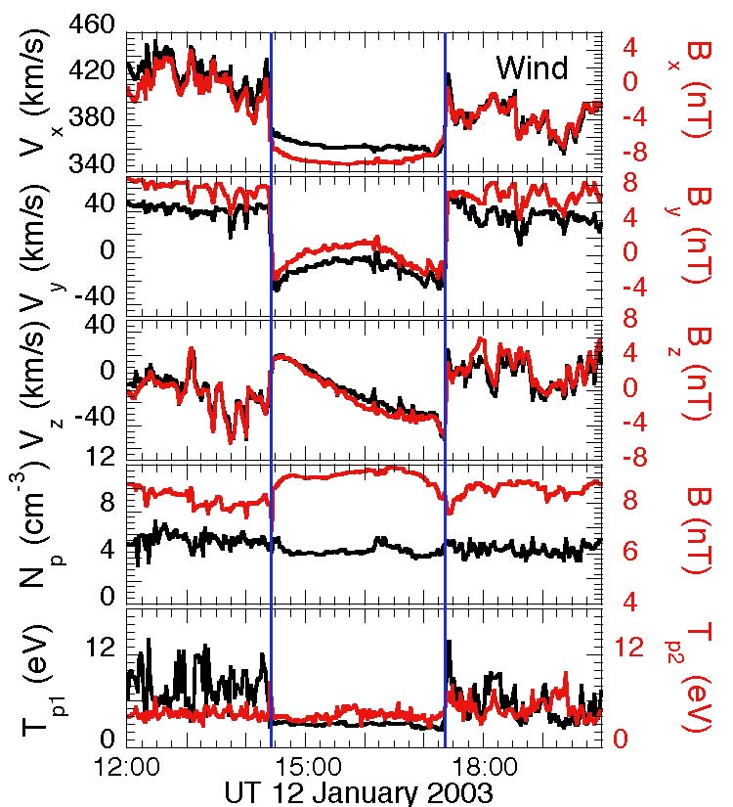
Comparison of Crooker et al. Vortical Event with 12 January 2003 Flux Rope

Slide 13
Sketch of the 12 January 2003 Flux Rope

Slide 14
A MHD Reconstruction of the Flux Rope Field and Stream Lines at Wind
Planar Projections
Field lines in black
Stream lines in red

Slide 15
Alexis Roullard
Joint in situ – imaging possibilities for understanding ICMEs with applications to small transients entrained in
stream interaction regions

Slide 16
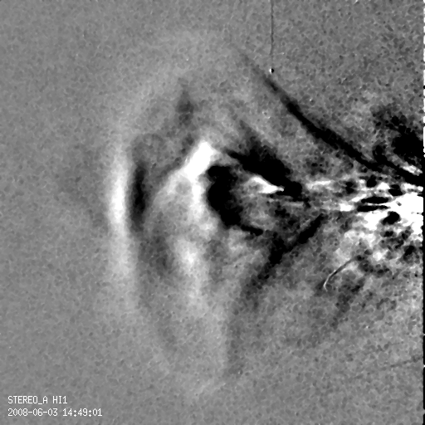
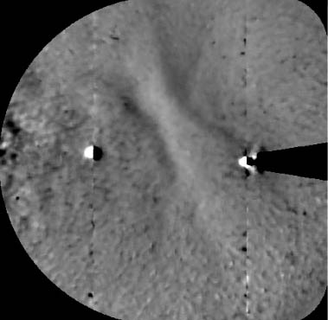
The aspect of CMEs can often be interpreted in coronagraphs using a croissant-shaped flux rope, higher up in the atmosphere the aspect of CME changes dramatically through expansion of the flux rope, solar-wind pile-up (shock formation) and CIR-CME interaction.
Sun
flux
rope
accumulated
plasma
expansion
SECCHI HI-1A
sheath
Venus
Earth
CIR-MC
interaction
HI-2B 2008/06/03 01:29 UT
SECCHI HI-2B images
Formation of merged interaction region

Slide 17
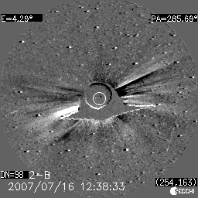
SECCHI reveals that arch-like structures are continually ejected from streamers (2 to 3 loops are observed per day at one longitude (probably 18 per day for the entire belt).
Another example of an arch-like structure:
The closed field must open
(footpoint exchange).

Slide 18
